Slide 1
Add and Subtract Fractions: Same Denominator
EQ – How do we add and subtract fractions with the same denominator?
Mrs Stretch
Year 7

Slide 2
How do we convert between fractions?
Mixed Fraction to Improper Fraction
Improper Fraction to Mixed Fraction

Slide 3
24
7
30
Add and Subtract Fractions: Same Denominator
Date
EQ – How do we add and subtract fractions with the same denominator?
Method 1
Adding With Same Denominator
$$\frac{1}{7}+\frac{4}{7}$$

Slide 4
24
7
30
Add and Subtract Fractions: Same Denominator
Date
EQ – How do we add and subtract fractions with the same denominator?
Method 1
Adding With Same Denominator
$$\frac{1}{7}+\frac{4}{7}$$

Slide 5
24
7
30
Add and Subtract Fractions: Same Denominator
Date
EQ – How do we add and subtract fractions with the same denominator?
Method 1
Adding With Same Denominator
$$\frac{1}{7}+\frac{4}{7}$$

Slide 6
24
7
30
Add and Subtract Fractions: Same Denominator
Date
EQ – How do we add and subtract fractions with the same denominator?
Method 1
Adding With Same Denominator
$$\frac{1}{7}+\frac{4}{7}=\frac{5}{7}$$

Slide 7
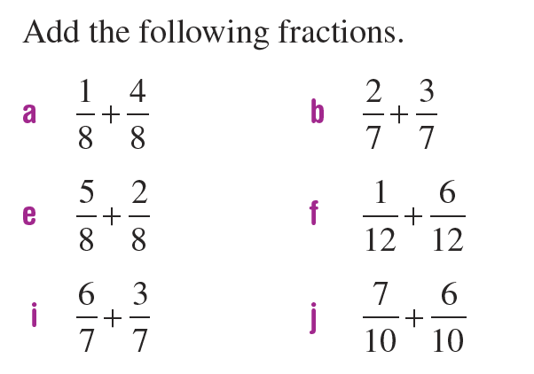
Practice

Slide 8

24
7
30
Add and Subtract Fractions: Same Denominator
Date
EQ – How do we add and subtract fractions with the same denominator?
Method 1
Subtracting With Same Denominator
$$\frac{6}{7}−\frac{2}{7}$$

Slide 9
24
7
30
Add and Subtract Fractions: Same Denominator
Date
EQ – How do we add and subtract fractions with the same denominator?
Method 1
Subtracting With Same Denominator
$$\frac{6}{7}−\frac{2}{7}$$

Slide 10
24
7
30
Add and Subtract Fractions: Same Denominator
Date
EQ – How do we add and subtract fractions with the same denominator?
Method 1
Subtracting With Same Denominator
$$\frac{6}{7}−\frac{2}{7}$$

Slide 11

24
7
30
Add and Subtract Fractions: Same Denominator
Date
EQ – How do we add and subtract fractions with the same denominator?
Method 1
Subtracting With Same Denominator
$$\frac{6}{7}−\frac{2}{7}=\frac{4}{7}$$

Slide 12
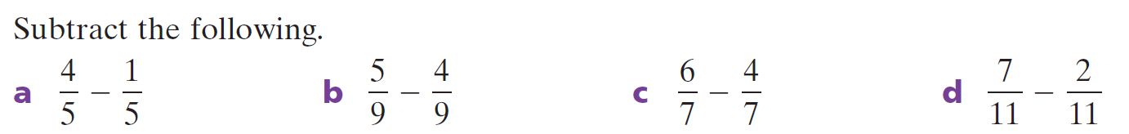

Slide 13
24
7
30
Add and Subtract Fractions: Same Denominator
Date
EQ – How do we add and subtract fractions with the same denominator?
Method 2
Mixed Numbers
$$3\frac{2}{3}+4\frac{2}{3}$$
Step 1: Add the whole numbers together then the fractions
$$3+4 \frac{2}{3}+\frac{2}{3}$$

Slide 14
24
7
30
Add and Subtract Fractions: Same Denominator
Date
EQ – How do we add and subtract fractions with the same denominator?
Step 2: Simplify the answer.
$$7 + \frac{4}{3}$$
$$\frac{4}{3}=1\frac{1}{3}$$
$$7 +1\frac{1}{3}=8\frac{1}{3}$$
Method 2
Mixed Numbers

Slide 15
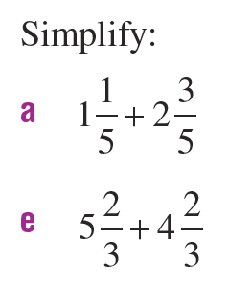
Practice

